Slide 1
Conceptual Models
What is the “objective”? What/who is relevant to that objective?
Sustainability is not inherently “good”.
Sustainability only means something is not decreasing
Sustainable development: non-declining welfare for future generations
Whose welfare are we measuring? Whose is not included?
How is welfare measure?
Consumption only?
What about inequities within the current generation? Environmental Justice concerns?

Slide 2
What’s “good”?
Good is normative
What is worth maximizing? What is the objective?
Q1 Pset 1: Modeling the profit made off a fishery
Profit is only comprised of revenue from selling fishing and cost of catching fish
This model of the system does not include any intrinsic worth for fish.
The only people we’ve included as relevant are fishermen

Slide 3



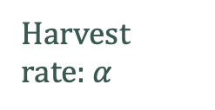

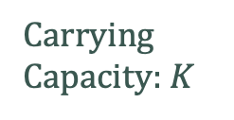



Economic Program
Ecological Program
Harvest rate: $α$
Revenue = ${pH}_{t}$
Fish ($X_{t}$)
Carrying Capacity: $K$
Harvest: $H_{t}=αX_{t}$
Profit ($π_{t}$)
Intrinsic growth rate: $r$
Initial population:
$X_{0}$
Cost = $−\frac{c}{2}\frac{H_{t}^{2}}{X_{t}}$

Slide 4










National
GYE
Economic Program
Livestock Loss ($L_{t}$)
$$L(s_{t})$$
Ecological Program
Grizzly Bears ($s_{t}$)
Carrying Capacity: $Z$
Conservation Spending ($C_{t}$)
$$Z(C_{t})$$
Intrinsic growth rate: $r$
Initial population:
$N_{0}$
Benefit ($B_{t}$)
$$B(s_{t})$$
Notes:
Livestock loss is

